Slide 1
Lung Cancer Predication
20211512
20211491
20211451
20211342
20211511
حسن محمد حسن محمود
سرور أسامة إسماعيل شلش
احمد رمضان فرج
عبدالله عبدالنعيم عطا
چون بولس جاد الرب

Slide 2
Problem
We’re given a dataset that contains information about cancer patients and our job is to train a model to predict the patient’s cancer stage. (Low, Medium, High)

Slide 3
About the Dataset
This dataset contains information on patients with lung cancer, including their age, gender, air pollution exposure, alcohol use, dust allergy, occupational hazards, genetic risk, chronic lung disease, balanced diet, obesity, smoking, passive smoker, chest pain, coughing of blood, fatigue, weight loss ,shortness of breath ,wheezing ,swallowing difficulty ,clubbing of fingernails and snoring.
Kaggle Link: https://www.kaggle.com/datasets/thedevastator/cancer-patients-and-air-pollution-a-new-link

Slide 4
What Model we Utilized
Classification
Random-Forest-Classifier
Classification is a supervised machine learning method where the model tries to predict the correct label of a given input data. We’ve decided to use classification in this project since our goal is to predict if a patient falls under certain categories.
Random forest is a commonly-used machine learning algorithm trademarked by Leo Breiman and Adele Cutler, which combines the output of multiple decision trees to reach a single result. Its ease of use and flexibility have fueled its adoption, as it handles both classification and regression problems. It’s simplicity and effectiveness in our use-case is the exact reason we chose this method.

Slide 5
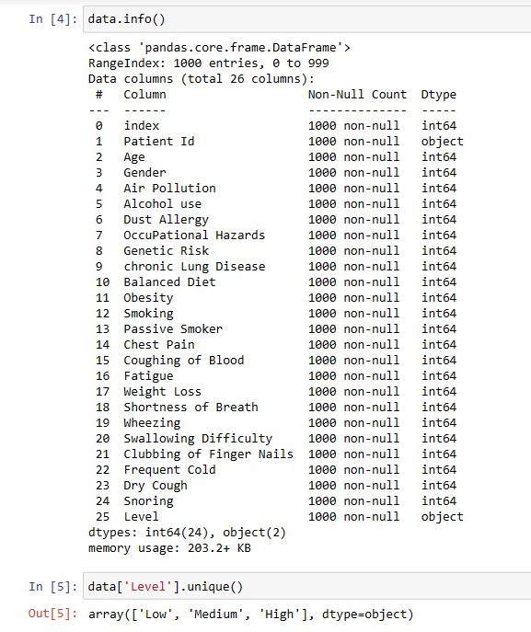
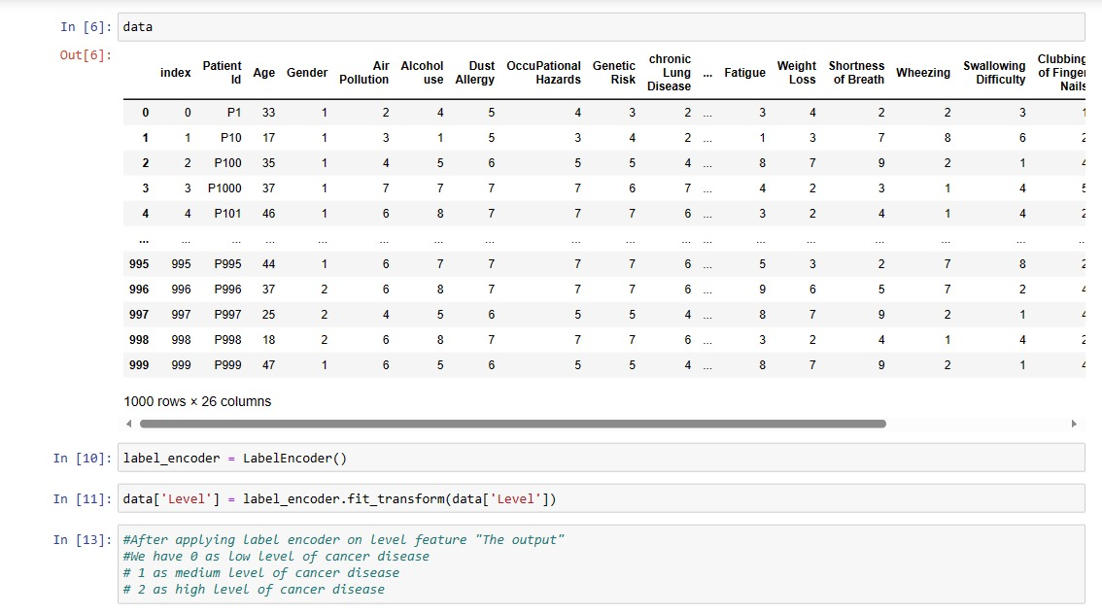
Code Review
Firstly, we determined what categories will our patients fall into by using the .unique() python method, getting all the unique values in the "Level" column in our dataset. Then, we used the encoder "LabelEncoder" to transform our categories in the "Level" column to values representing different cancer stages. 0 being low, 1 medium and finally 2 as high.

Slide 6
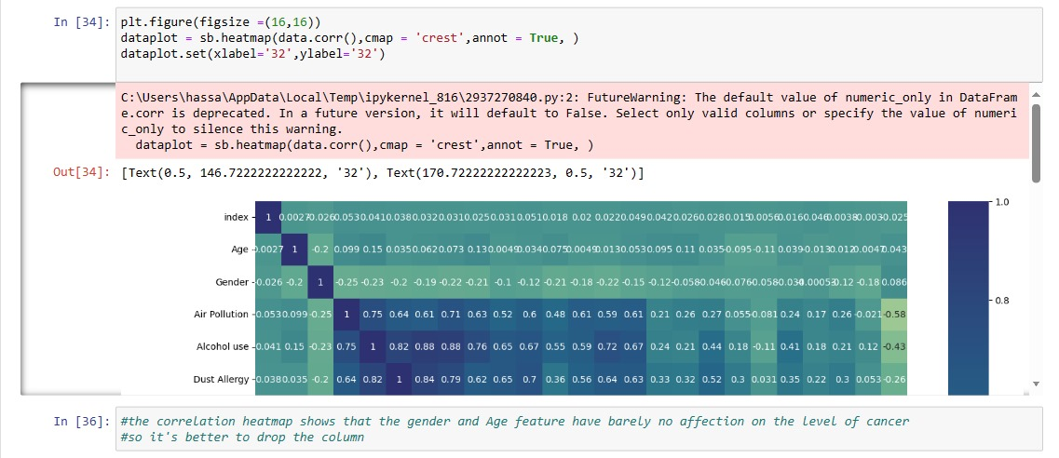
Code Review
Secondly, we used a correlation heatmap to determine features/columns that have no effect on the level/stage of the patient's lung cancer. After determining the columns with no effect such as gender and age, we drop them.

Slide 7
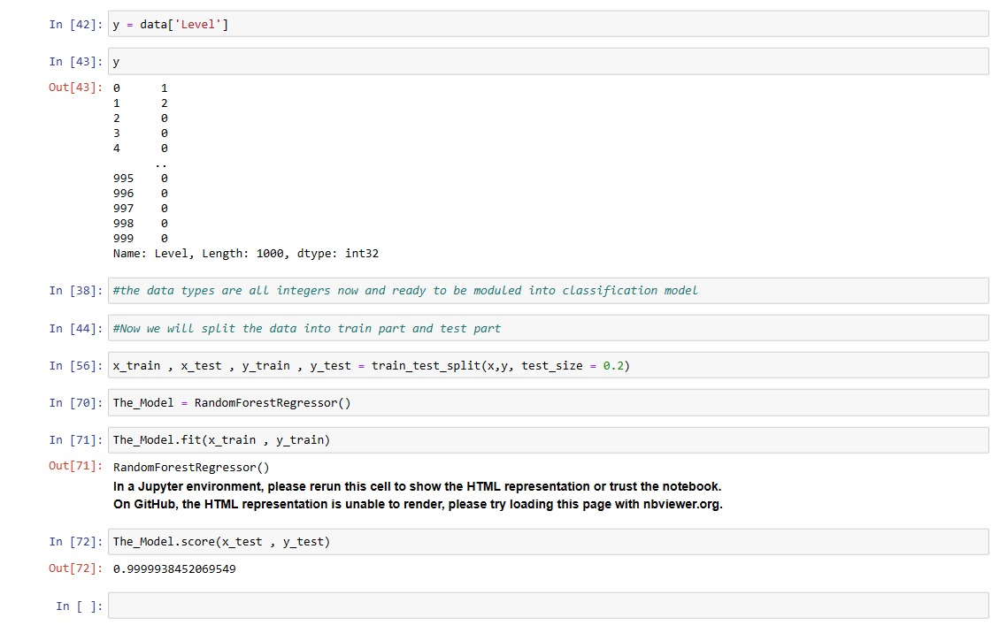
Results
Finally, we have the results after splitting the dataset and fitting/training our model. Our model's accuracy turned out being 99%, which might seem too high but comparing it to other people's models on keggle we find that such an accuracy is normal.

Slide 8
THANK YOU
GitHub Repository Link: https://github.com/Sourour2002/Machine-Learning-Project

